Slide 1
Lan Mode Principle / Implementation
Benson Chuang
31 July 2017

Slide 2
Agenda
What’s Lan mode
Lan mode operation
Implementation
API
Key Exchange
Encryption, Decryption, Encapsulation
Lan Mode Simulation

Slide 3
What’s Lan Mode

Slide 4
Lan Mode Goals
Reduce latency of event generation and consumption, without compromising security or power management.
Enable Module to Mobile Application communication when the Device Service is not reachable.
Module supports up to two simultaneous LAN mode mobile applications.

Slide 5

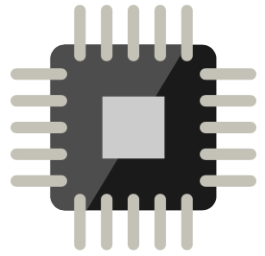

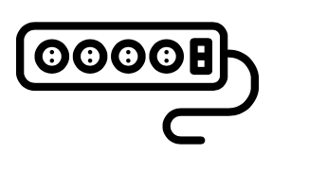



Lan Session Topology
LAN Status : enable
Auto Sync : 1
LAN IPKEY : qT+auR+3FclF4gW48kjGRItQU3XdNg==
LAN KEY ID : 813
Keep alive : 30
Lan Parameters
(Uploaded by command queue)
Device session
Cloud session
Ayla Module
MCU
Lan session
http server
http client
http client
http server

Slide 6
Lan Mode Operation

Slide 7
Start LAN Mode Session
http server
1
Establish LAN Mode Session
http client
202
MCU
Ayla Module
2
random_1
time_1
Key Exchange
http server
http client
200
random_2
time_2
3
LAN Mode Enabled

Slide 8
Ask Datapoint from Device
http server
1
Notify Device
http client
200
MCU
Ayla Module
2.1
2
req
Get command
http server
http client
res
200
Property Name
3
Property Name
Value
http client
Post Datapoint
http server
200

Slide 9
Post Datapoint to Device
http server
1
Notify Device
http client
200
MCU
Ayla Module
2.1
2
Update
Get command
http server
http client
ADS
200
Property Name
Type
Value
2.2
Update

Slide 10
Keep Lan Mode Session
http server
Keep Alive
http client
200
Ayla Module

Slide 11
Implementation

Slide 12
Device/Cloud LAN Mode Function
Implement following URI at both Device and Clouds’ HTTP server
LAN session:
Retrieve lankey
Establish LAN Mode
Notify device
Keep Alive
Key Exchange
Get command
Post datapoint

Slide 13
Retrieve lankey
ADS – Get Lan configuration
URI=/apiv1/devices/<$ID>/lan.json
METHOD=GET
200=Success
Req: Lan configuration
LAN Status : enable
Auto Sync : 1
LAN IPKEY : qT+auR+3FclF4gW48kjGRItQU3XdNg==
LAN KEY ID : 813
Keep alive : 30
Res: Lan configuration

Slide 14
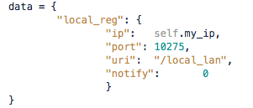
Establish Lan Mode Session
LAN API– APP establish Lan configuration
URI=/local_reg.json
METHOD=POST
202=Accepted
Establish Lan session
http server
http client
Copyright © 2015 Ayla Networks
14

Slide 15
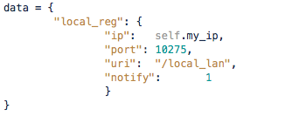
Notify Device
LAN API– Ask device get command from APP
URI=/local_reg.json
METHOD=PUT
202=Accepted
Notify Device
http server
http client
Copyright © 2015 Ayla Networks
15

Slide 16
Keep Alive
LAN API– Keep Alive
URI=/local_reg.json
METHOD=PUT
202=Accepted
Keep Alive
http server
http client
Copyright © 2015 Ayla Networks
16

Slide 17

Key Exchange
LAN API– Calculate a cipher suite
URI=/local_lan/key_exchange.json
METHOD=POST
200=Accepted
Key Exchange
http client
http server
Copyright © 2015 Ayla Networks
17

Slide 18
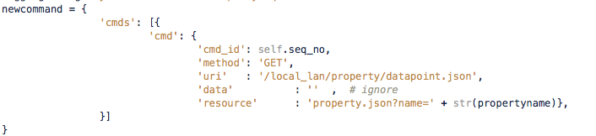

Get command
LAN API– Retrieve the command from APP
1.1
Have command
1.2
No command
URI= /local_lan/commands.json
METHOD=GET
200=Accepted
Encapsulation
2
Get command
http client
http server
Copyright © 2015 Ayla Networks
18

Slide 19

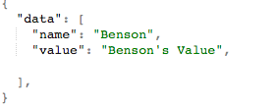
Post datapoint
LAN API– Send datapoint to APP
URI /local_lan/property/datapoint.json
METHOD=POST
200=Accepted
Decryption
Post datapoint
http client
http server
Copyright © 2015 Ayla Networks
19

Slide 20
Key Exchange Detail

Slide 21
Key Exchange – 1. Exchange Key Pairs
http server
1
Establish LAN Mode Session
http client
202
Ayla Module
2
random_1
time_1
Key Exchange
http server
http client
200
random_2
time_2
Device sends 16 bytes random string along with current time to APP
APP generate 16 bytes random string along with current APP time to Device
Calculate IV seed and sign at both sides(APP and Device)
Copyright © 2015 Ayla Networks
21

Slide 22
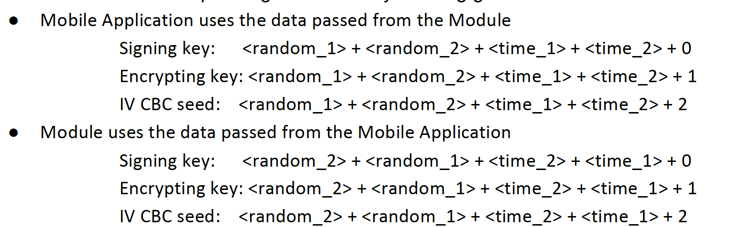
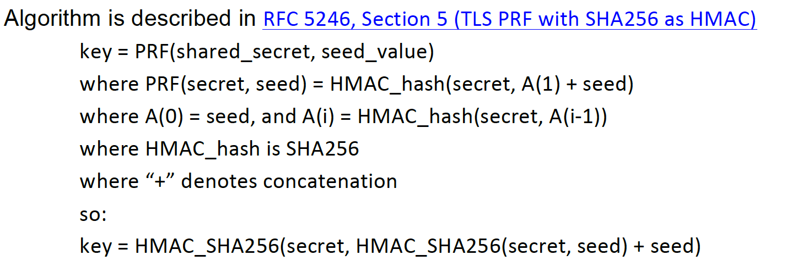
Key Exchange – 2. Algorithm
Copyright © 2015 Ayla Networks
22

Slide 23
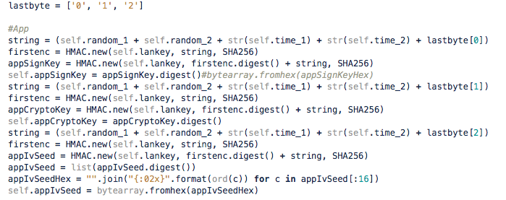
Key Exchange – 3. Calculation – APP Key
0
1
2
3
Copyright © 2015 Ayla Networks
23

Slide 24
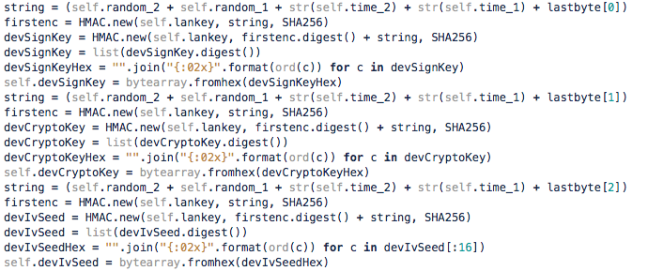
Key Exchange – 4. Calculation – Device Key
0
1
2
3
Copyright © 2015 Ayla Networks
24

Slide 25
Encryption, Decryption, Encapsulation

Slide 26
Encryptor
Encryptor is stateful
Only initial encryptor once when doing Key Exchange
Encryptor is encrypted string by using CBC with AES 256
encryptor = AES.new(str(self.appCryptoKey), AES.MODE_CBC, str(self.appIvSeed))

Slide 27

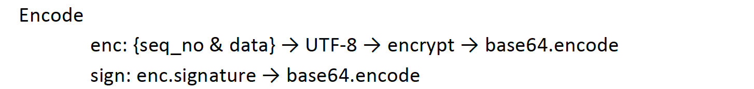
Encryption and Encapsulation - 1
The response format of GET command sent by device
1
newcommand
2
3
Padding, 16-byte alignment
2
1
3
Copyright © 2015 Ayla Networks
27

Slide 28
Encryption and Encapsulation - 2
The response format of GET command sent by device
4
encrypted_data = encryptor.encrypt(padding_data)
encryptedb64 = base64.b64encode(encrypted_data)
5
newcommand
sign = HMAC.new(str(appSignKey), enclist_str, SHA256)
6
7
signb64 = base64.b64encode(sign.digest())
4
5
6
7
Copyright © 2015 Ayla Networks
28

Slide 29

Encryption and Encapsulation - 3
The response format of GET command sent by device

Slide 30
Decryptor
Decryptor is stateful
Only initial decryptor once when doing Key Exchange
decryptor = AES.new(str(self.devCryptoKey), AES.MODE_CBC, str(self.devIvSeed))

Slide 31
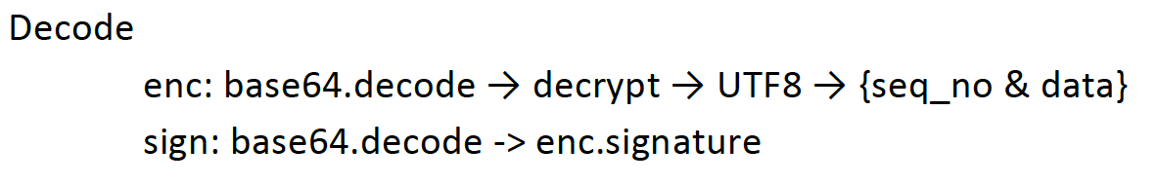
Decryption
When APP receives datapoint update from device
2
1
3
1
2
3

Slide 32
Lan Mode Simulator

Slide 33
Architecture
lansession
Ayla Module
lansession
lansession
lansession
lanbridge
HTTP
Server
CLI
Set prop
Config
Commands
IP
demux
Get prop
Datapoints
Display
module
Callback
POST/PUT local_reg

Slide 34
Appendix

Slide 35
Reference
Wi-Fi Module REST API Specification
AMAP Source Code
DeviceParadise : Module log interpreter
GetAllProperty is not supported by Ayla Production Agent(BlackBox)

Slide 36
Thank you
WWW.AYLANETWORKS.COM

